Slide 1
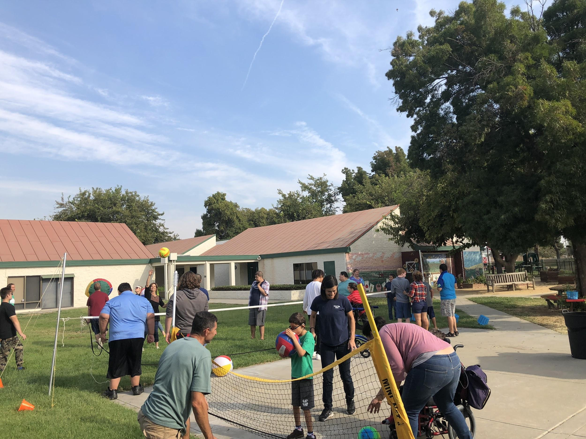
Greengate PE

Slide 2
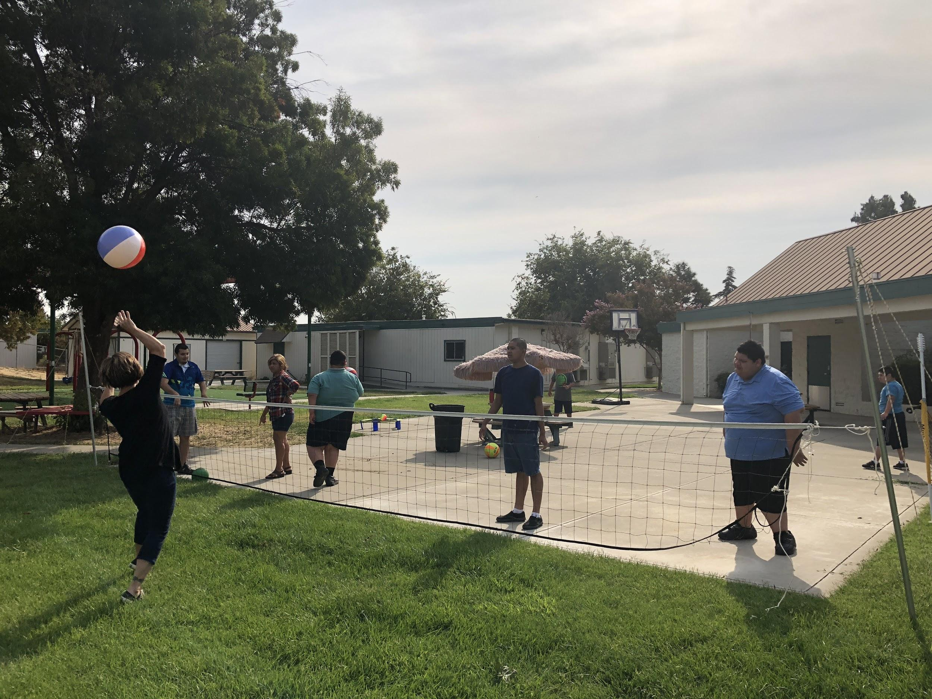
I used the YCOE mini grant to purchase Volleyball, bowling and other PE equipment. This equipment is used in our Wednesday morning PE program at Greengate.

Slide 3
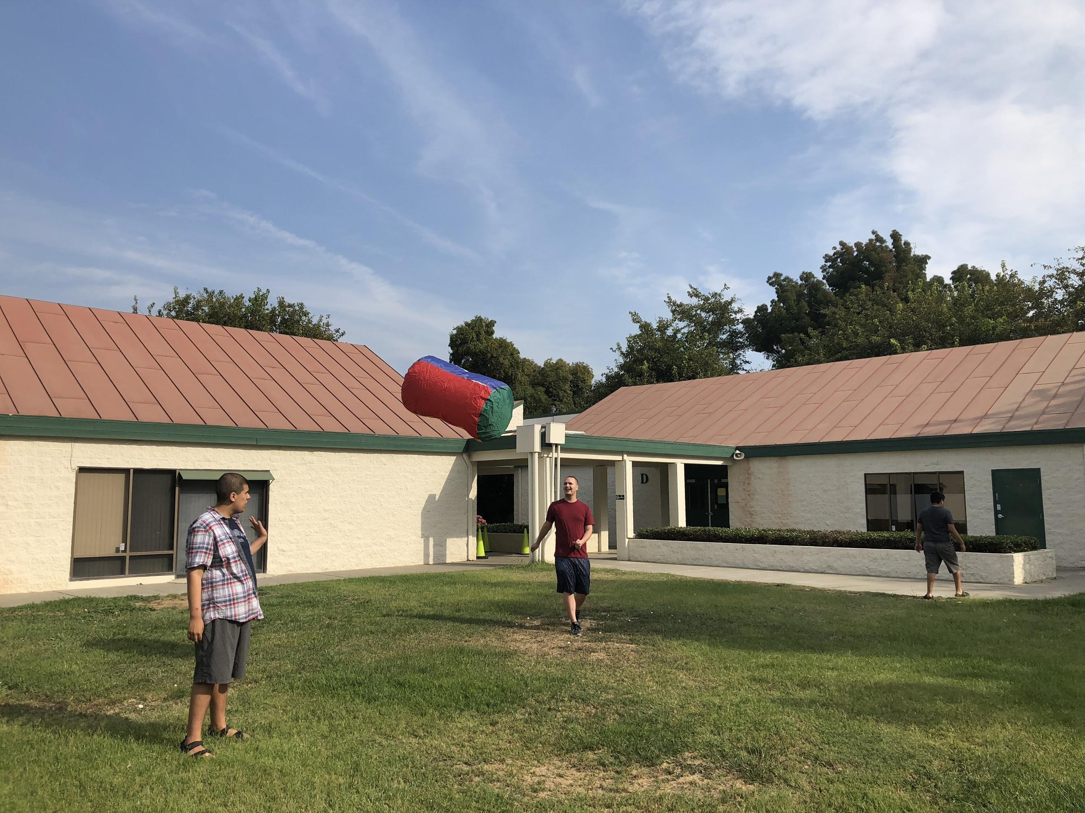
A volleyball net and a variety of adapted volleyballs were purchased to make make PE accessible to all students.

Slide 4
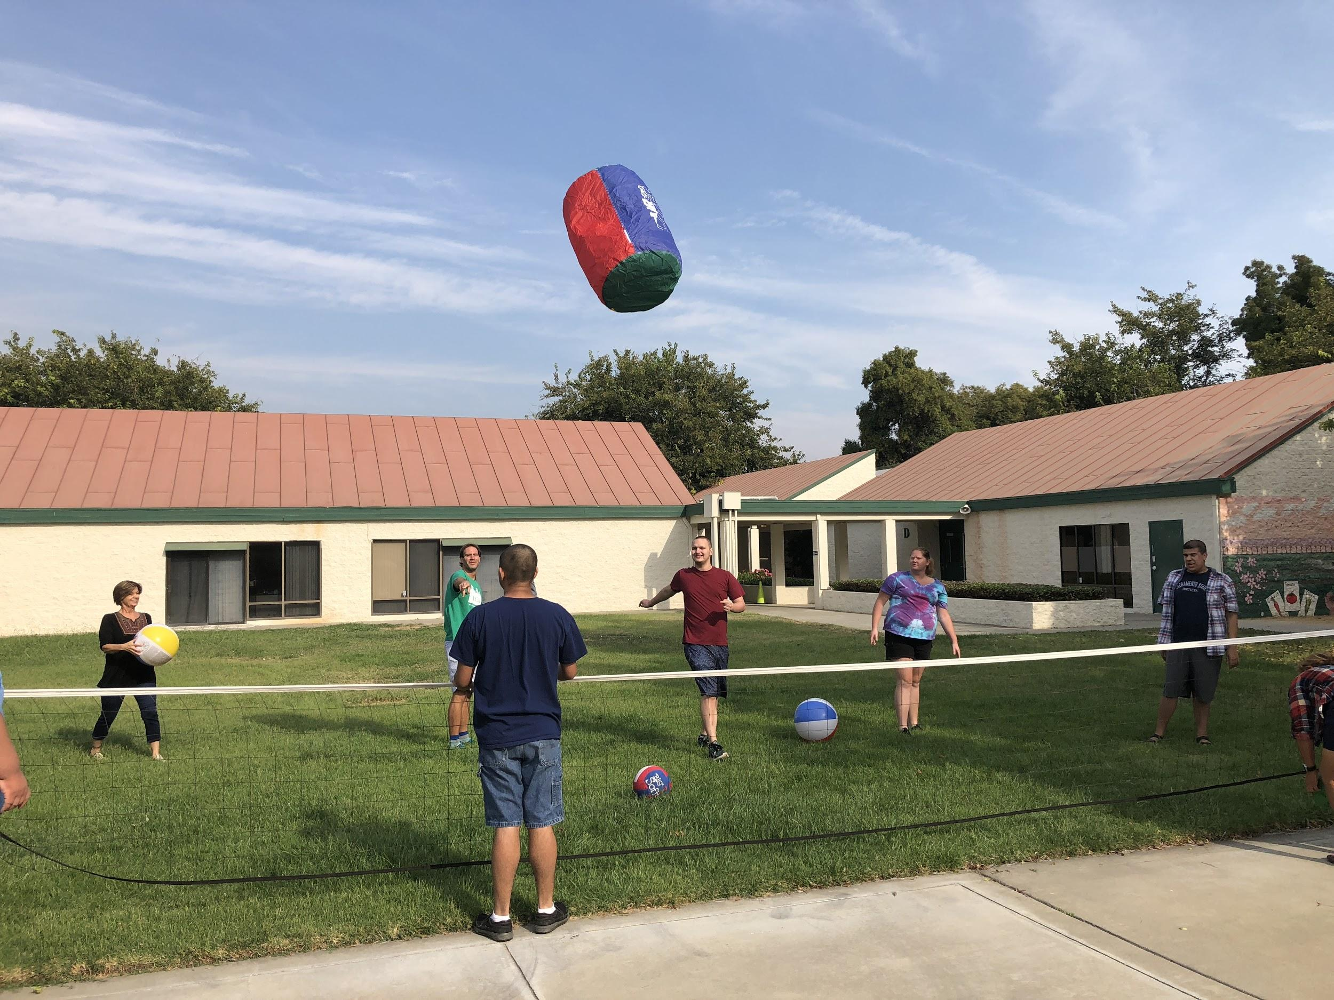
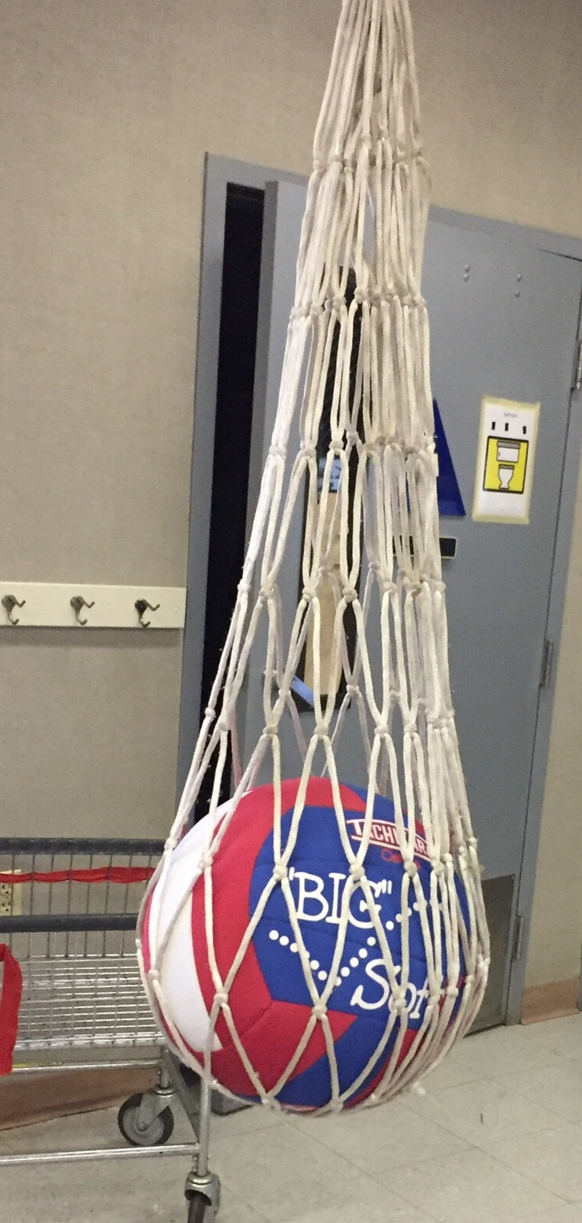
Volleyball

Slide 5
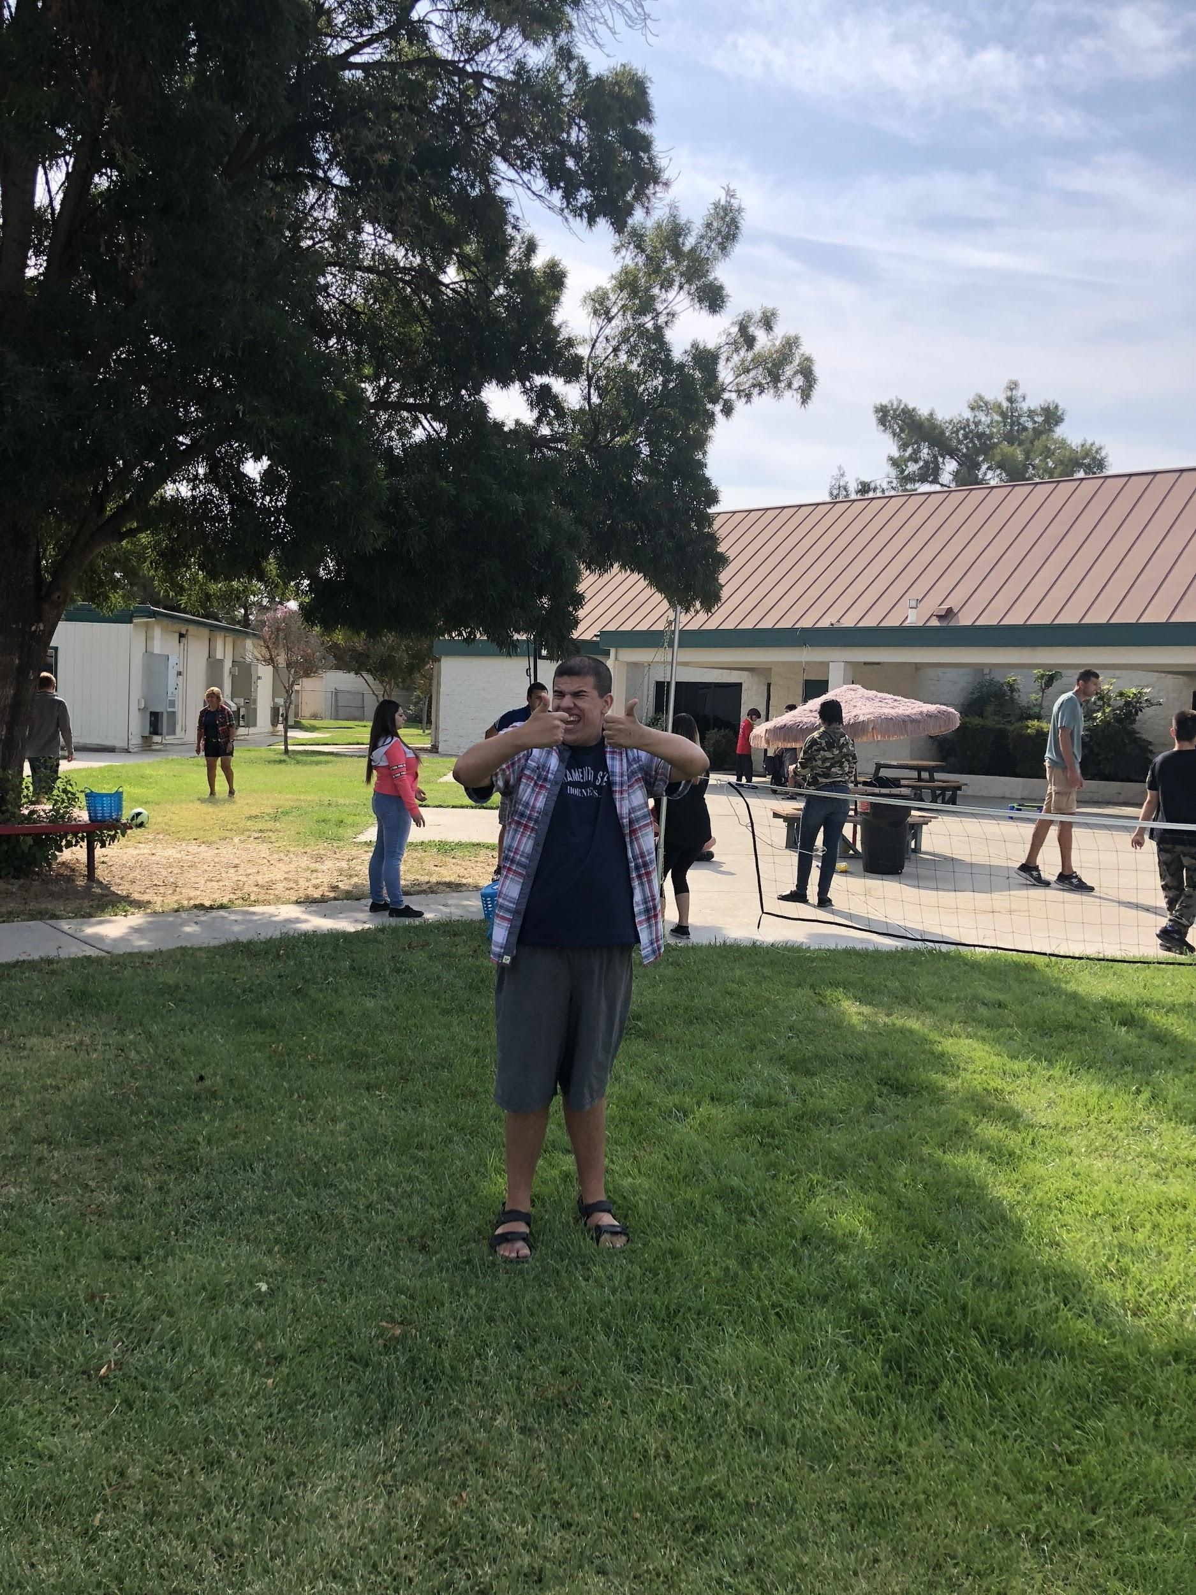
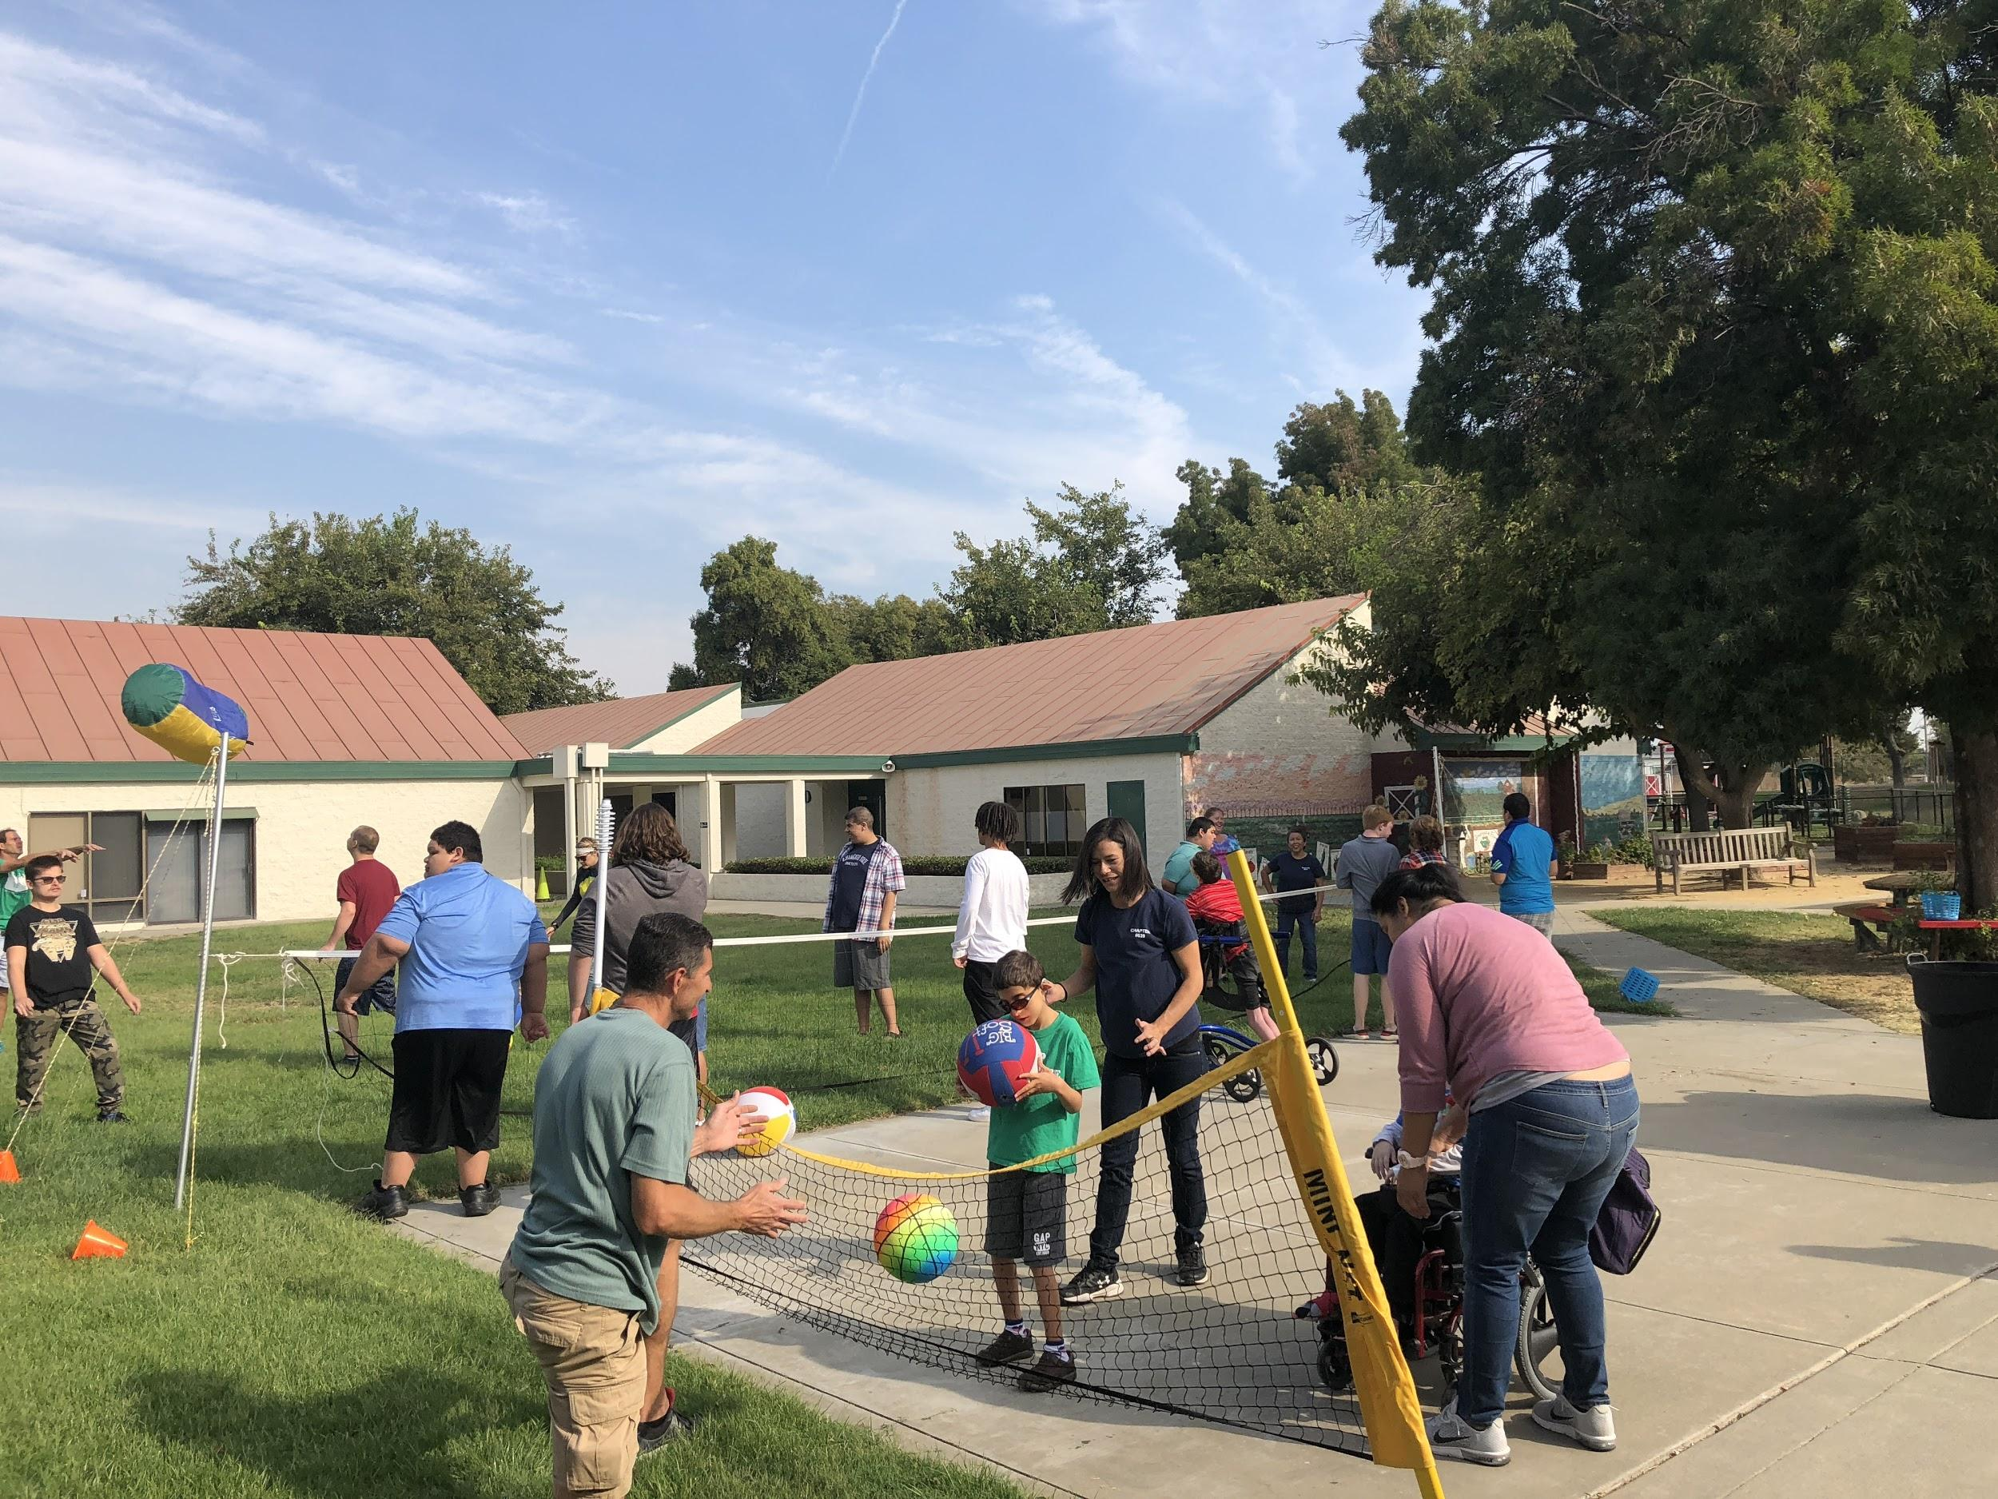
Everyone is included and having fun.

Slide 6
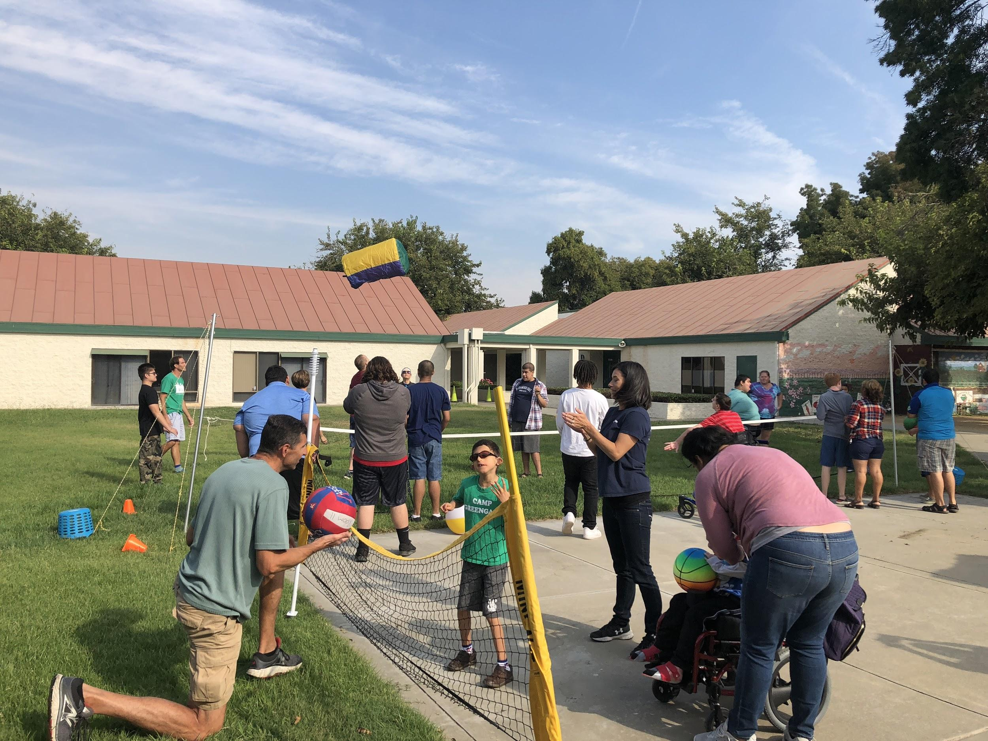

Slide 7
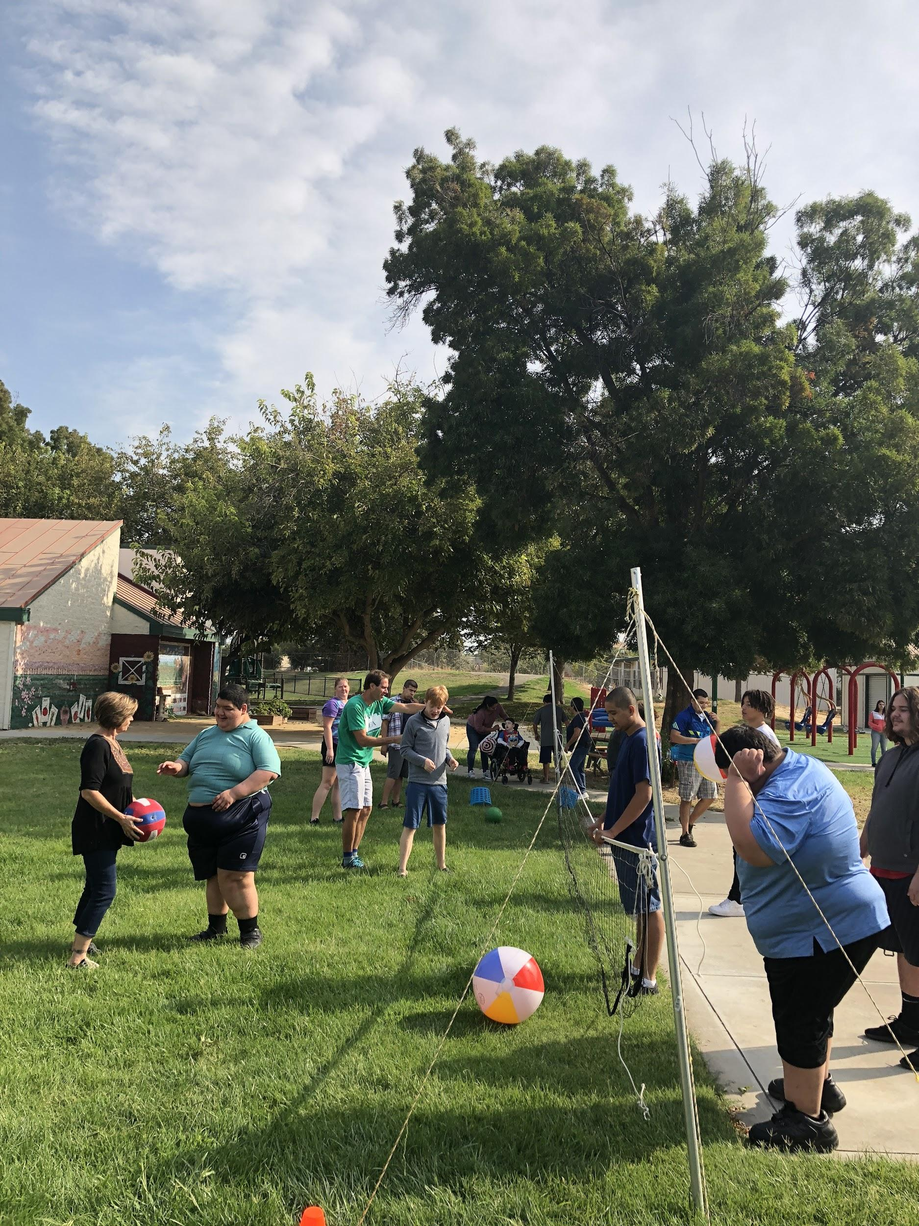
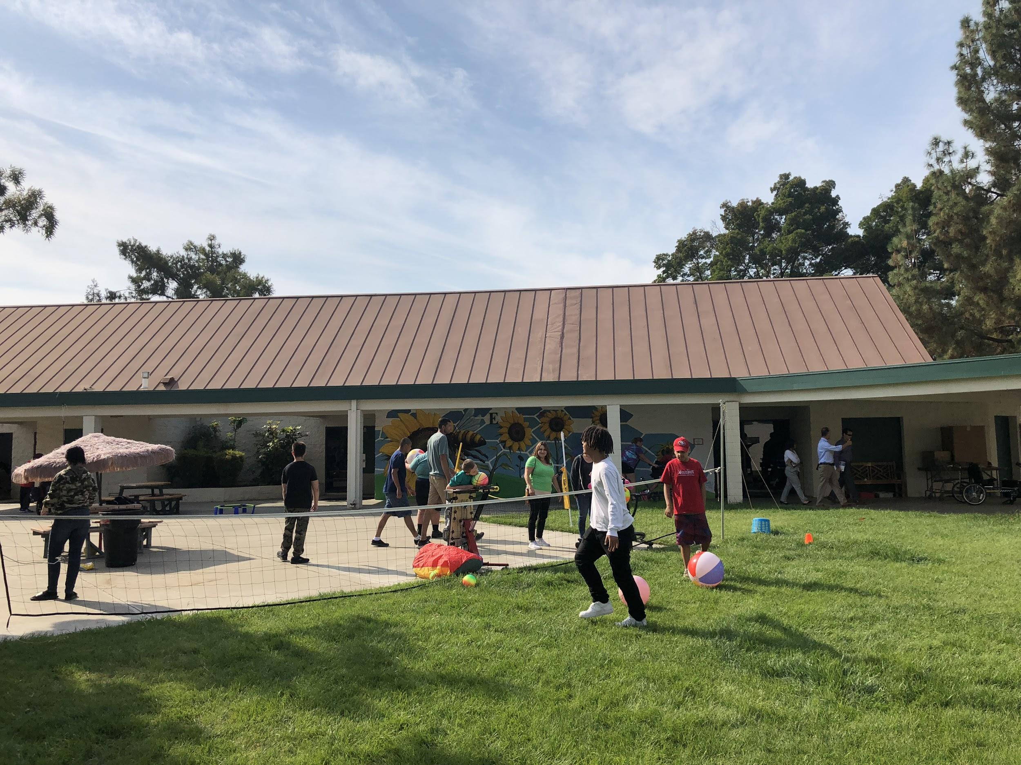
Students from Cesar Chavez work as PE coaches by setting up equipment, helping students and having fun.

Slide 8
